Slide 1

Mathematical Modeling and Engineering Problem solving
Chapter 1

Slide 2
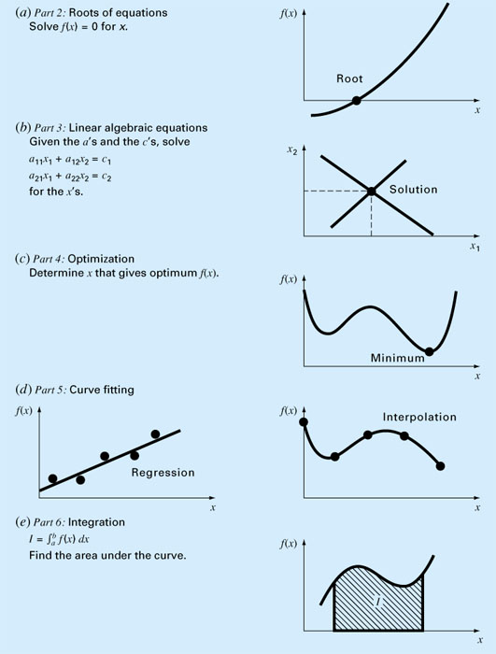
Every part in this book requires some mathematical background

Slide 3
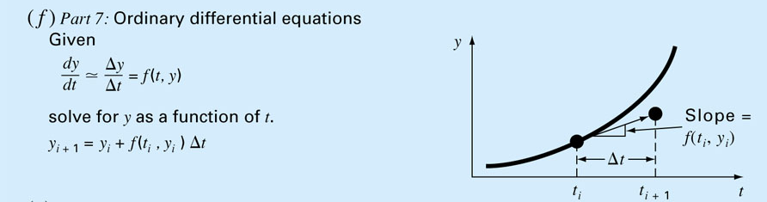
Computers are great tools,
however, without fundamental understanding of engineering problems, they will be useless.

Slide 4
Engineering Simulations
Finite element analysis (FEA) and product design services
Computational Fluid Dynamics (CFD)
Molecular Dynamics
Particle Physics
N-Body Simulations
Earthquake simulations
Development of new products and performance improvement of existing products
Benefits of Simulations
Cost savings by minimizing material usage.
Increased speed to market through reduced product development time.
Optimized structural performance with thorough analysis
Eliminate expensive trial-and-error.

Slide 5
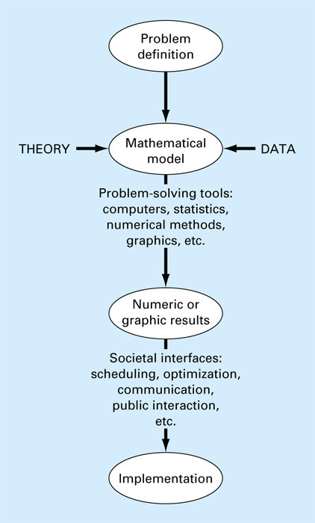
The Engineering
Problem Solving
Process

Slide 6
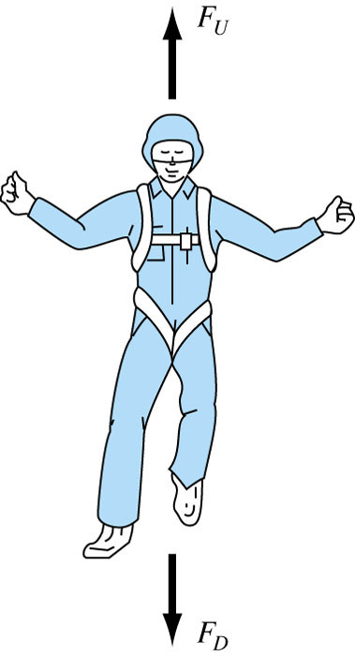

Newton’s 2nd law of Motion
“The time rate change of momentum of a body is equal to the resulting force acting on it.”
Formulated as F = m.a
F = net force acting on the body
m = mass of the object (kg)
a = its acceleration (m/s²)
Some complex models may require more sophisticated mathematical techniques than simple algebra
  Example, modeling of a falling parachutist:
  F_{U} = Force due to air resistance = -cv (c = drag coefficient)
  F_{D} = Force due to gravity = mg

Slide 7
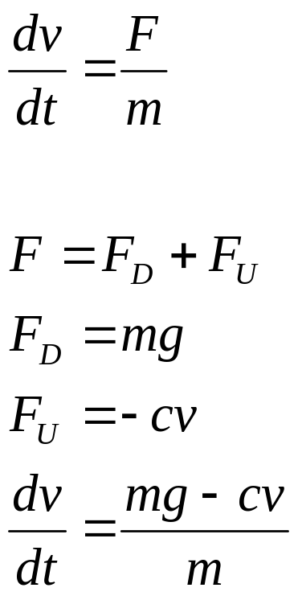
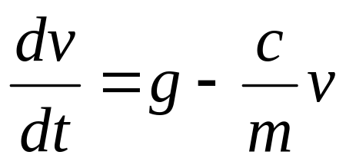
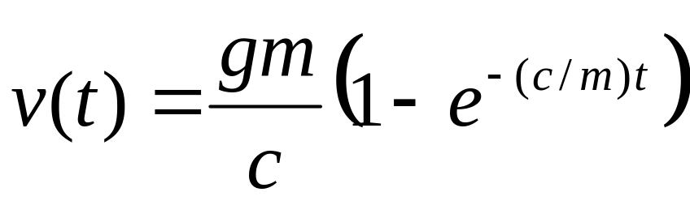
This is a first order ordinary differential equation. We would like to solve for v (velocity).
It can not be solved using algebraic manipulation
Analytical Solution:
If the parachutist is initially at rest (v=0 at t=0), using calculus dv/dt can be solved to give the result:
Independent variable
Dependent variable
Forcing function
Parameters

Slide 8
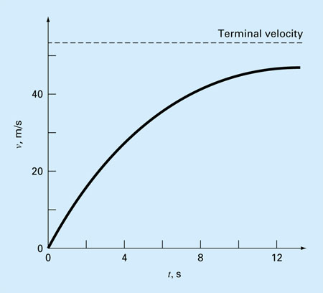
Analytical Solution
If v(t) could not be solved analytically, then
we need to use a numerical method to solve it
g = 9.8 m/s² c =12.5 kg/s
m = 68.1 kg
t (sec.) | V (m/s)
0 | 0
2 | 16.40
4 | 27.77
8 | 41.10
10 | 44.87
12 | 47.49
∞ | 53.39
**Run analpara.m, analpara2.m, and analpara4.m
at W:\228\MATLAB\1-2

Slide 9
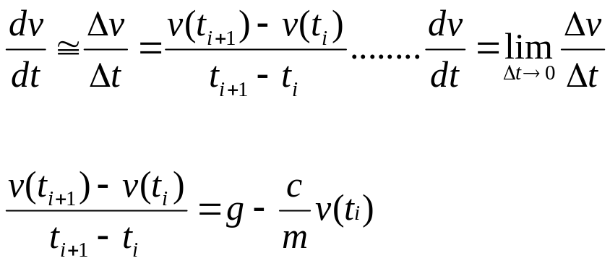
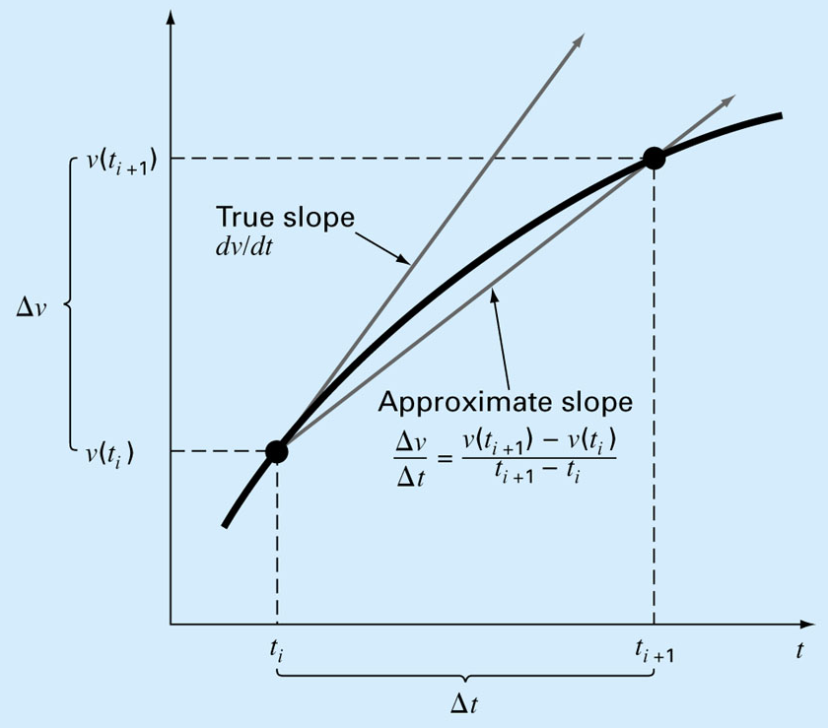
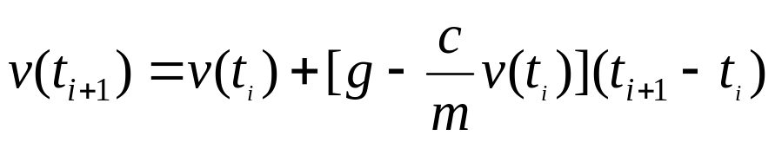
Numerical Solution
This equation can be rearranged to yield
t (sec.) | V (m/s)
0 | 0
2 | 19.60
4 | 32.00
8 | 44.82
10 | 47.97
12 | 49.96
∞ | 53.39
∆t = 2 sec
To minimize the error, use a smaller step size, ∆t
No problem, if you use a computer!

Slide 10
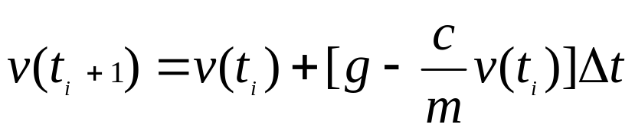
Analytical
vs.
Numerical solution
m=68.1 kg c=12.5 kg/s
g=9.8 m/s
∆t = 2 sec
∆t = 0.5 sec
∆t = 0.01 sec
t (sec.) | V (m/s)
0 | 0
2 | 16.40
4 | 27.77
8 | 41.10
10 | 44.87
12 | 47.49
∞ | 53.39
t (sec.) | V (m/s)
0 | 0
2 | 19.60
4 | 32.00
8 | 44.82
10 | 47.97
12 | 49.96
∞ | 53.39
t (sec.) | V (m/s)
0 | 0
2 | 17.06
4 | 28.67
8 | 41.95
10 | 45.60
12 | 48.09
∞ | 53.39
t (sec.) | V (m/s)
0 | 0
2 | 16.41
4 | 27.83
8 | 41.13
10 | 44.90
12 | 47.51
∞ | 53.39
CONCLUSION: If you want to minimize the error, use a smaller step size, ∆t
*Run numpara2.m at W:\228\MATLAB\1-2

